Slide 1
DRDC project results and Magnetic nanoparticle imaging
Yutong Zhao
Jan 28th 2019

Slide 2
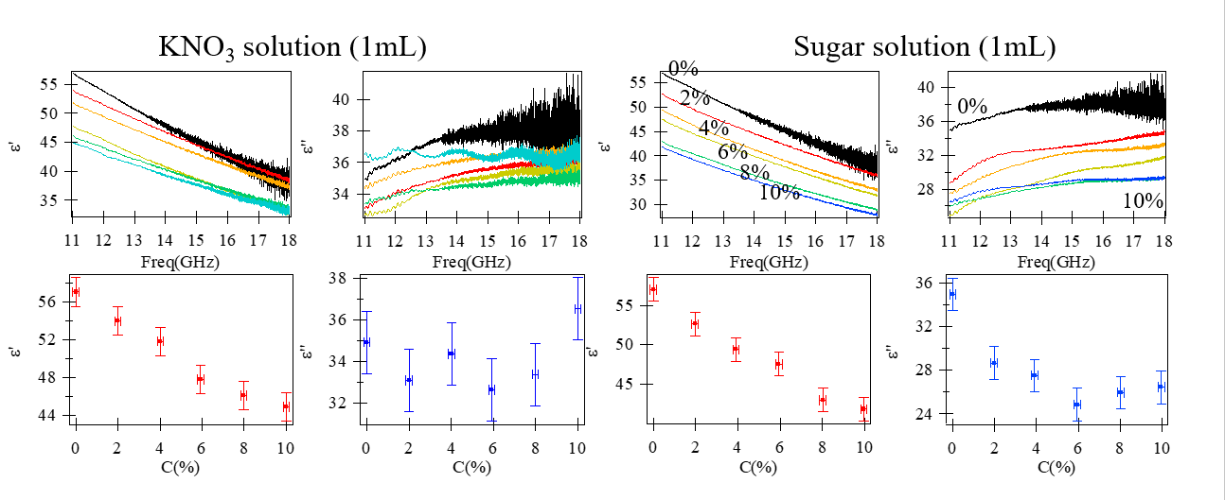
DRDC project results

Slide 3
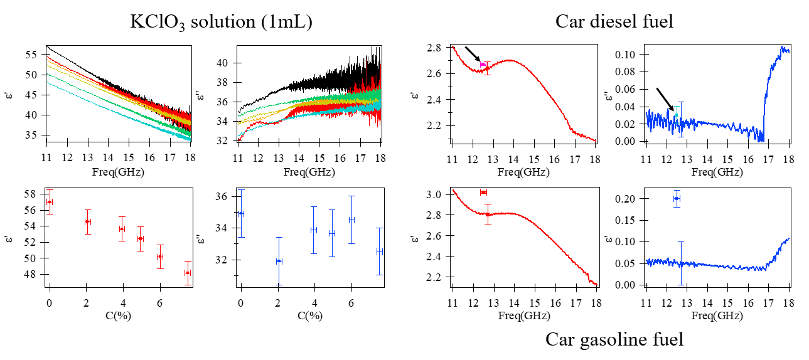
DRDC project results

Slide 4
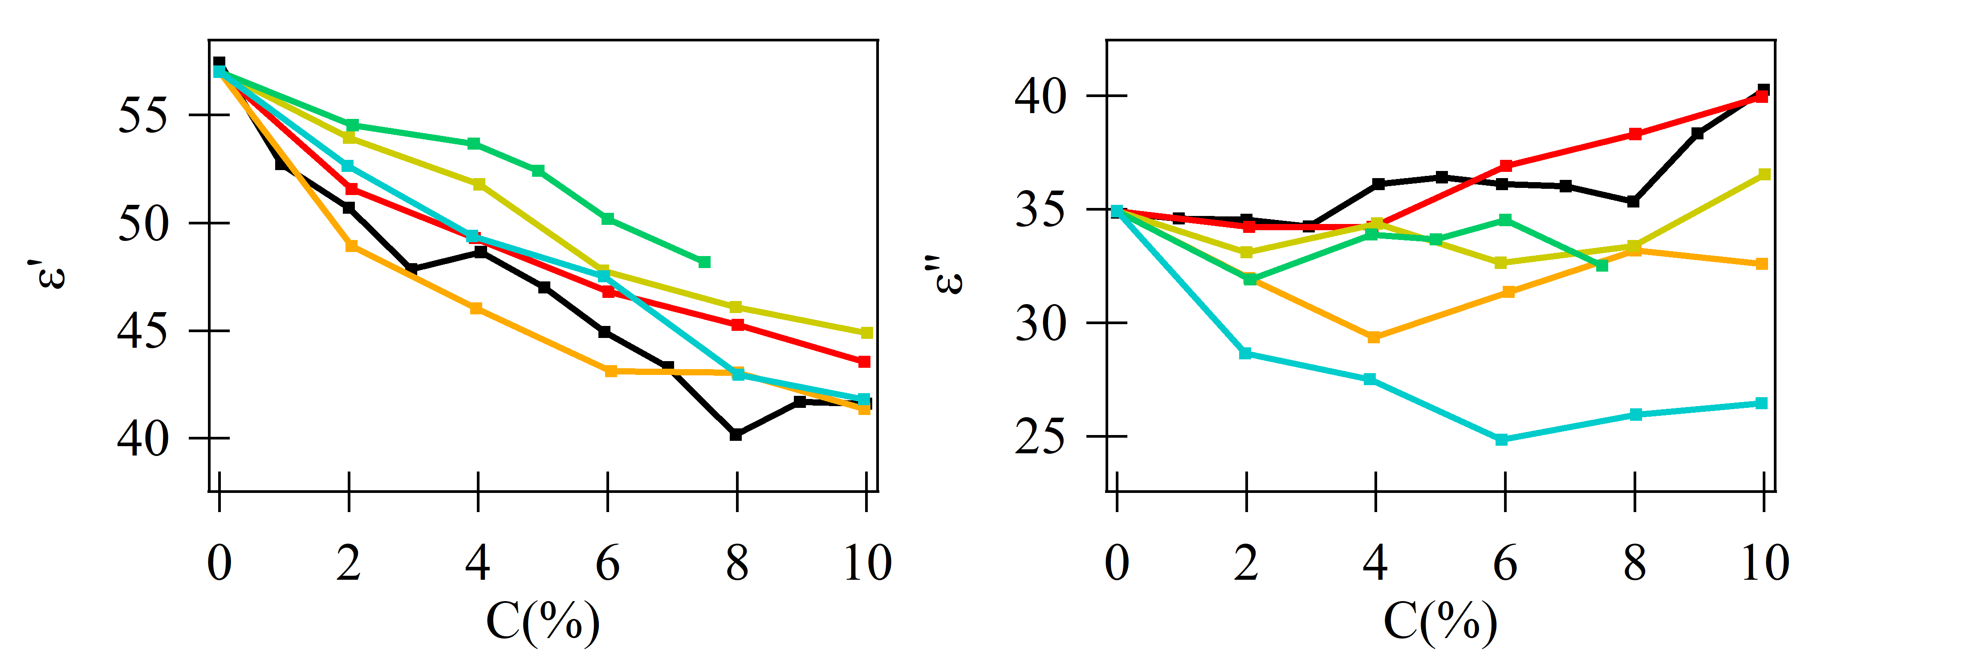
Summary of solutions
Real part
Imaginary part
NaCl
NH₄NO₃
KClO₃
NaNO₃
KNO₃
Sugar
Conclusion:
We determined 5 ionic solutions and 1 molecular solution.
Real part: all of these solutions decrease with the concentration (C).
Imaginary part: NaCl, NH4NO₃ increase and Sugar drops with C.
Remaining problem:
For gasoline, it has been stored 1 year. The high evaporation property may result the difference.
Solution： get some fresh gasoline from gas station.

Slide 5
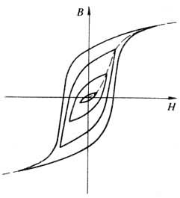

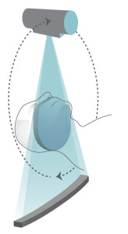
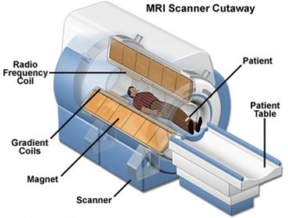
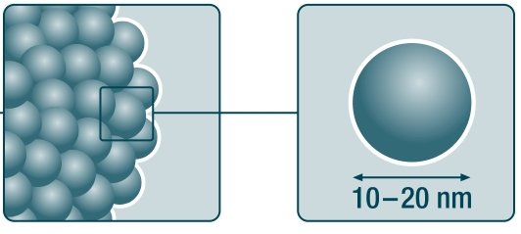
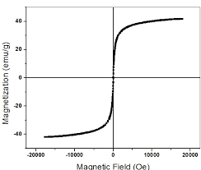
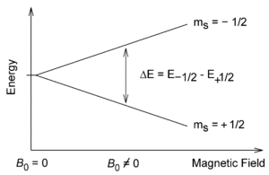
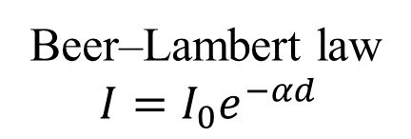



Medical imaging methods
3. Magnetic Particle Imaging(MPI)
1. Computed Tomography(CT)
2. Magnetic Resonance Imaging(MRI)
Sliced X-ray
Broadband RF signal
Beer–Lambert law
$$I=I_{0}e^{−αd}$$
$γ$- gyromagnetic ratio
$$ΔE=γℏB$$
$α$ – attenuation factor

Slide 6
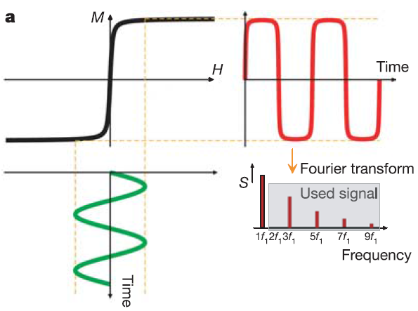
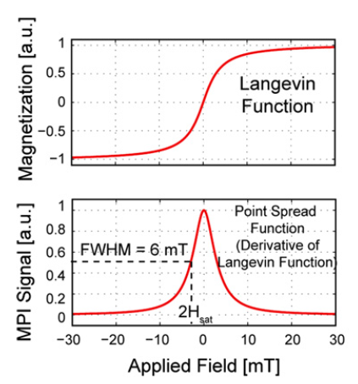
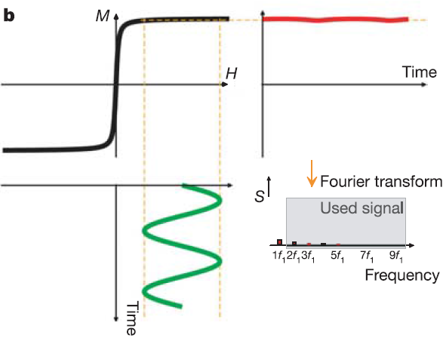
Response at different magnetic field for
Superparamagnetic nanoparticles

Slide 7
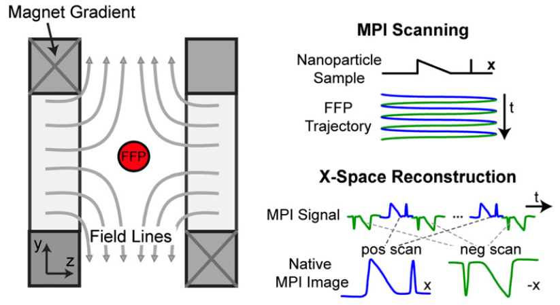
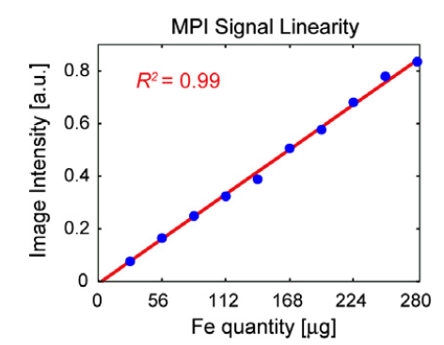
MPI principle

Slide 8
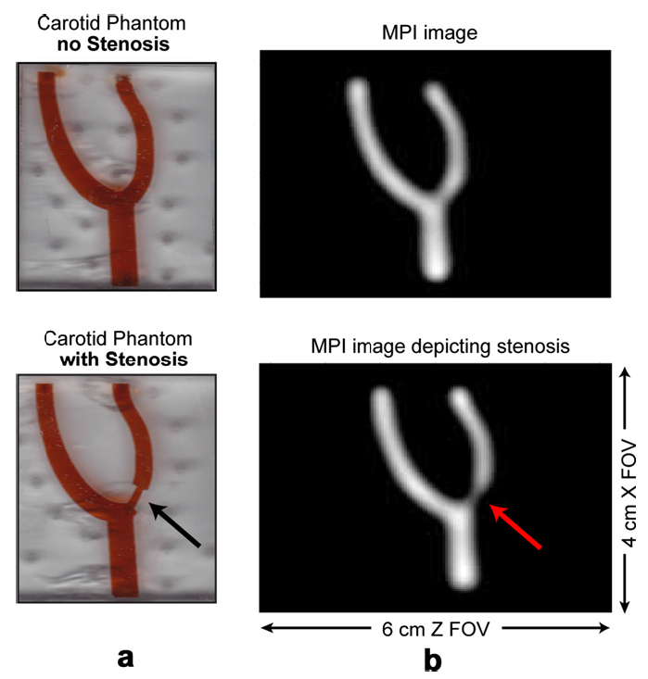
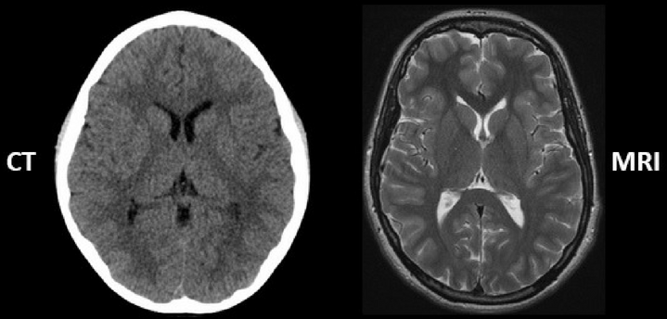
MPI: high resolution
CT：X-ray
Sensitive to heavy elements:
Bones (Calcium)
MRI：Larmor procession
Sensitive to light elements:
Soft tissue (Hydrogen)

Slide 9
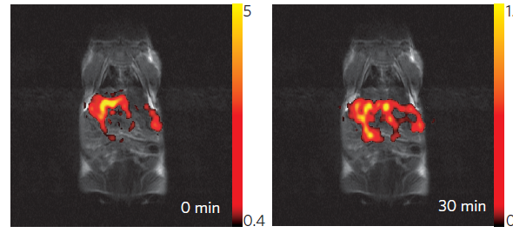
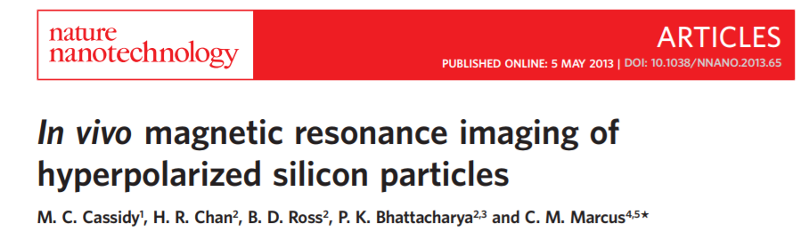
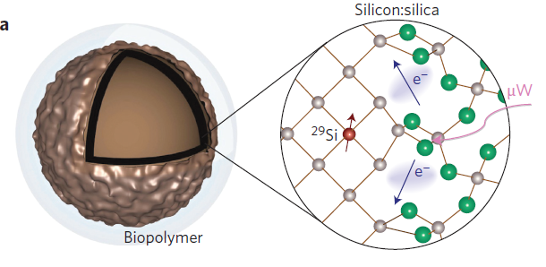
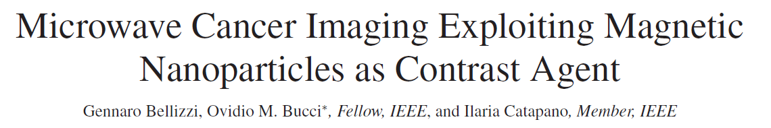
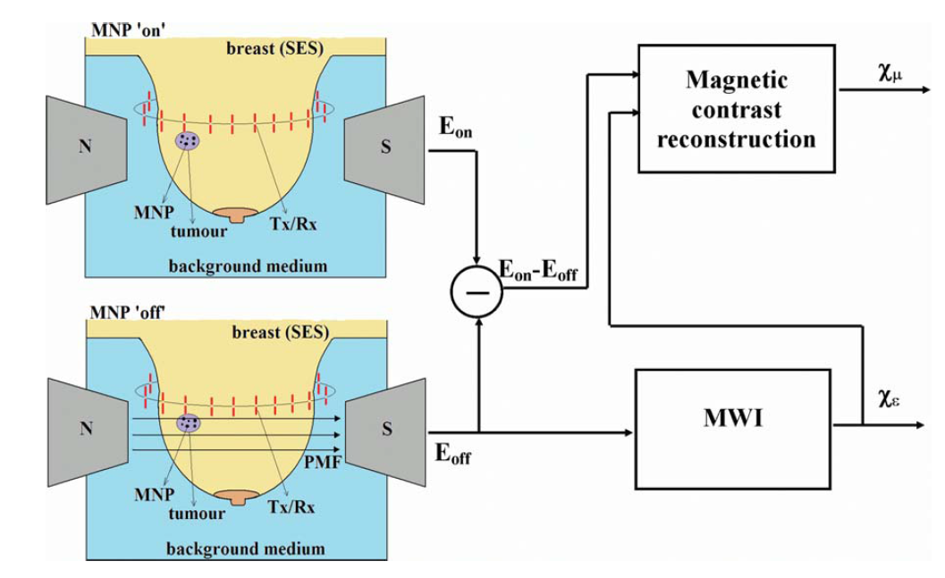
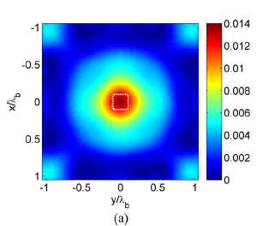
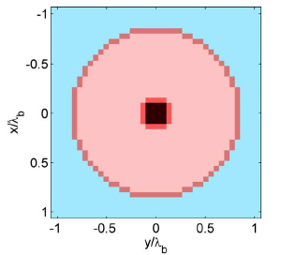

Slide 10
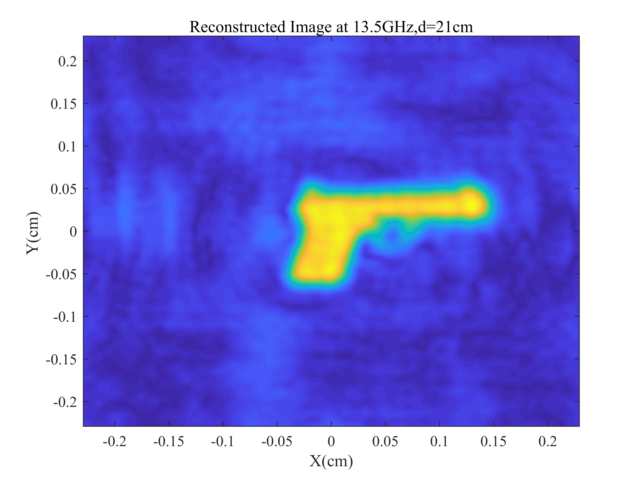
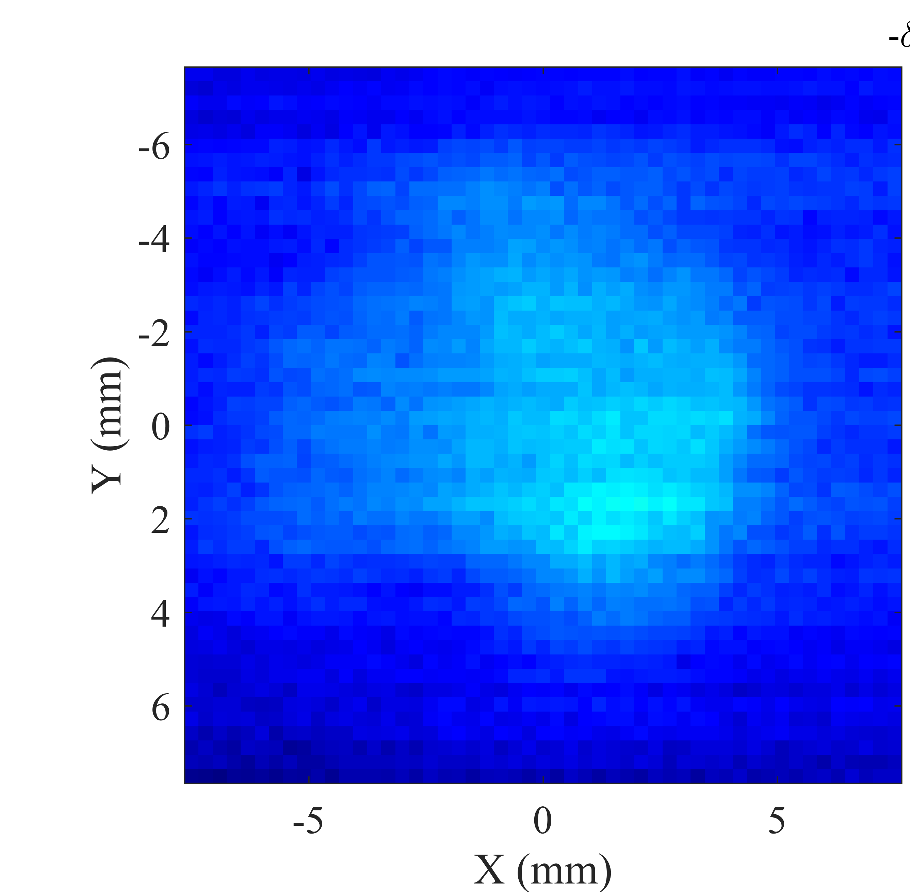
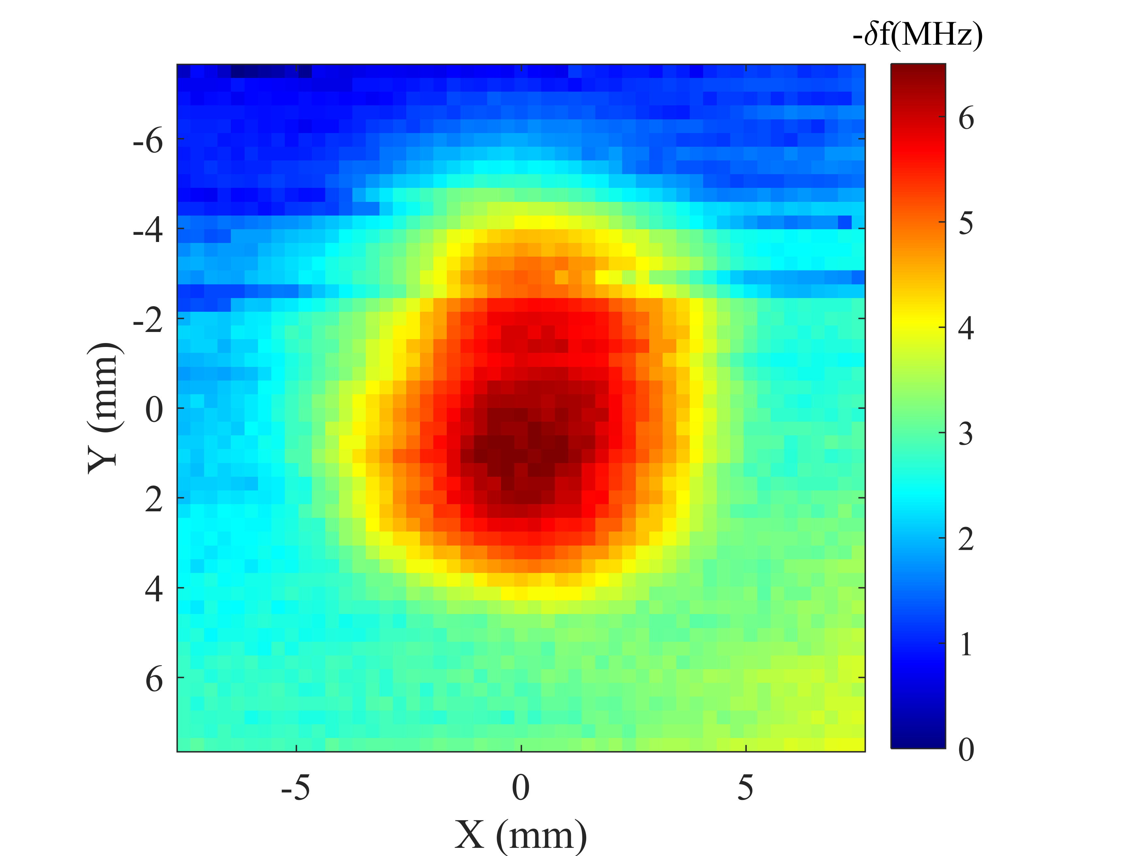
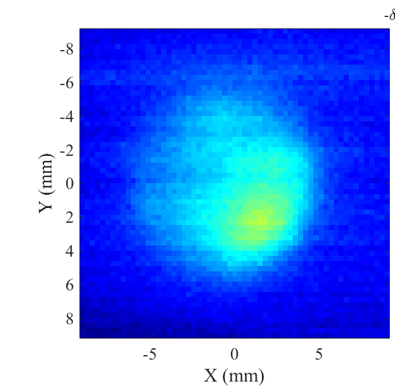
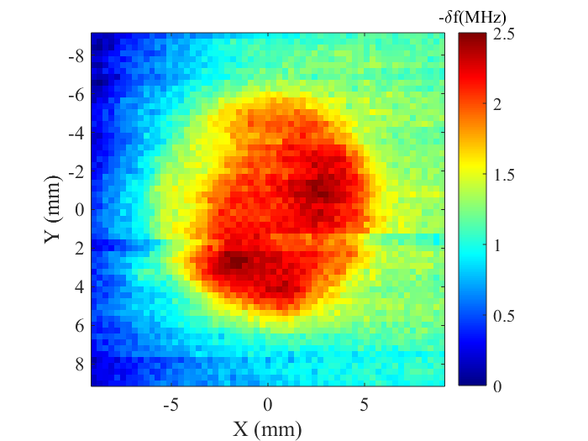

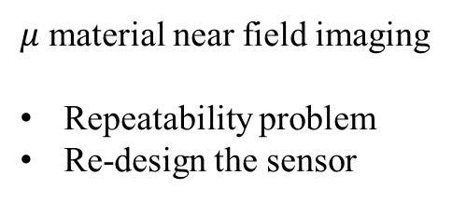
What we can do for MPI?
Without H field
With H field
Microwave imaging for nanoparticles
Imaging without strong H field?
Shallow in vivo imaging?
$μ$ material near field imaging
Repeatability problem
Re-design the sensor

